Slide 1

Federated Identity Management and eduGAIN training for ngREN
INTRODUCION
Mario Reale
Senior Research Engagement Manager GÉANT
Online, April 7, 2025

Slide 2
Agenda
I. Training goals
II. Training Structure
III. Training schedule
IV. Hands on part
V. Communication channels and web-references/links
VI. The Training team
Notes:
PRESENTED BY: MARIO

Slide 3
Training goals
Understand the basic principles of Federated Identity management
Understand the general concepts underlying eduGAIN and Identity Federations
Master also the more advanced features related to managing an Identity Federations
Overall goal: build the next generation of Identity Federation managers/operators for ngREN
This training is provided by the GÈANT Project GN5-2 WP5 and the AfricaConnect3 project, co-funded by the European Union
Notes:
PRESENTED BY: MARIO

Slide 4
II. Training implementation structure
Online-only
Lightweight
2 or 3 hours max - each session
Theory first
Hands-on part afterwards
Hands-on:
Trainees asked to implement steps on their own or in small groups ( e.g. 2 teams of 2 people each )
Following detailed steps provided by the HowTo online guides
After each technical session there will be a follow-up/catch-up sessions where the trainers will
assess the work carried out by the participants
help sorting out possible problems
Ensure everyone is ready to proceed further to the next technical session/steps
Notes:
PRESENTED BY: MARIO

Slide 5
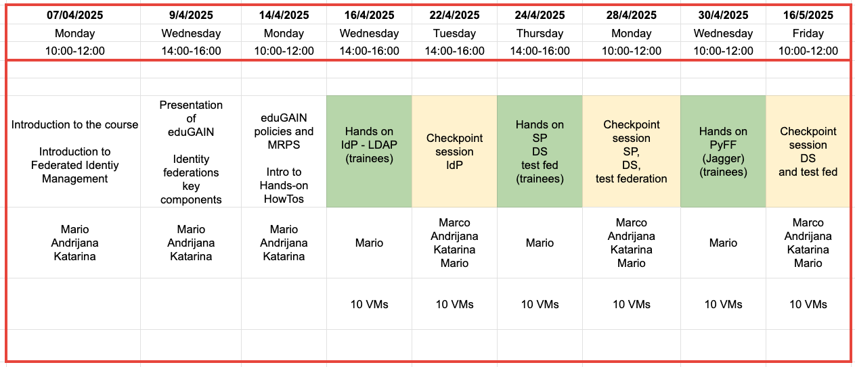
III. Training schedule (April 7 to May 16)
Notes:
PRESENTED BY: MARIO

Slide 6
IV. Hands-on sessions
Three technical hands-on sessions
Wednesday, April 16 13h-15h WAT (14h-16h CEST)
Set up LDAP server, the Shibboleth Identity provider
Checkpoint/Support session: Tuesday, April 22 13h-15h WAT
Thursday, April 24 13h-15h WAT (14h-16h CEST)
Set up Test Service Provider, Discovery Service, Test federation
Checkpoint/Support session: Monday, April 28 9h-11h WAT
Wednesday, April 30 9h-11h WAT (10h-12h CEST)
Set up PyFF as MDA (introduction to Jagger)
Checkpoint/Support session: Friday, May 16 9h-11h WAT
www.africaconnect3.net
Notes:
PRESENTED BY: MARIO

Slide 7
V. Communication channels / references
Slack workspace : geant-ac3-ngren.slack.com via Slack client or Web Interface https://geant-ac3-ngren.slack.com
Email
Web link:
https://github.com/GEANT/edugain-training/tree/main/materials

Slide 8
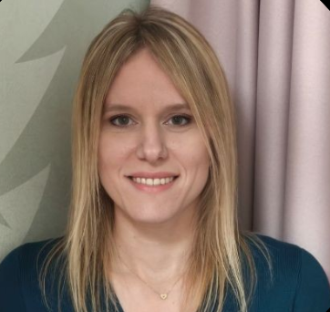
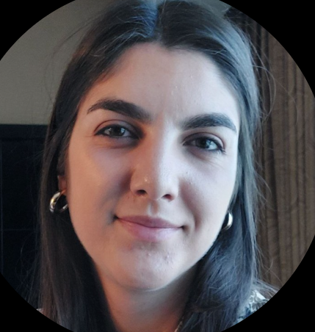
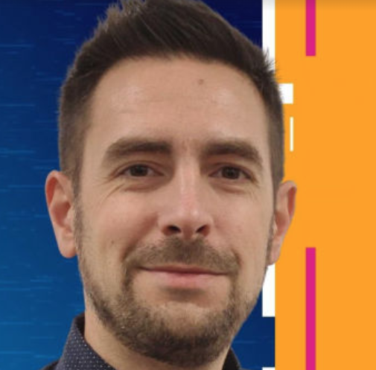
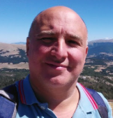
VI. The training team
Andrijana Todosijevic AMRES (Serbia)
User Services Department Lead andrijana.todosijevic@amres.ac.rs
Katarina Simonovic AMRES (Serbia)
User Services Engineer katarina.simonovic@amres.ac.rs
Marco Malavolti GARR / IDEM (Italy)
Senior Software Developer & Identity Federation Operator marco.malavolti@garr.it
Mario Reale GÈANT (The Netherlands)
Senior Research Engagement Manager mario.reale@geant.org
Andrijana
Katarina
Marco
Mario

Slide 9



Thank you
Any questions?
@AC3_News
AC3-Community
africaconnect3.net
Mario Reale mario.reale@geant.org
Notes:
PRESENTED BY: ALEX

